Slide 1
Web threats

Slide 2
Web threats
Web Threats Are Malicious Software Programs
Such As Spyware, Adware, Trojan Horse Programs, Bots, Viruses, Or Worms, Etc.
Are Installed On Your Computer Without Your Knowledge Or Permission.
These Programs Utilize The Web To Spread, Hide, Update Themselves And Send Stolen Data Back To Criminals.

Slide 3
Types of web threats
Malware A Software Program That Is Secretly Placed On Your Computer To Do Unexpected Or Unauthorized, But Always Malicious Actions.
Virus A Program That Can Copy Itself And, Like Real-life Viruses, Spread Quickly. Viruses Are Designed To Damage Your Computer, Display Unexpected Messages Or Images, Destroy ﬁ Les, Reformat Your Hard Drive, Or Take Up Storage Space And Memory In Your Computer Which May Slow It Down.
Worm A Self-contained Program That Can Spread Copies Of Itself To Other Computer Systems Through Network Connections, Email Attachments, Instant Messages (Via ﬁ Le-sharing Applications), And By Working With Other Malware.

Slide 4
Types of web threats
Trojan Horse A Program That Performs A Malicious Action But Cannot Replicate Itself. It May Arrive As A Harmless ﬁ Le Or Application With Hidden, Malicious Code. When It Is Executed, You May Experience Unwanted System Problems And Might Sometimes Lose Information From Your Computer.
Spam Any Message Sent By Email Or Instant Message (Im) That You Did Not Request And—is Designed To Make Money For The Sender.
Phishing Any Attempt By Phone, Email, Instant Message, Or Fax To Get Your Personal Information In Order To Steal Your Identity (And Your Money). Most Phishing Attempts Look Like They Are Designed For A Legitimate Purpose, But They Are Actually Intended To Be Used For Criminal Activity.

Slide 5
Types of web threats
Spyware Software That Is Installed Or Executed On Your Computer (Without Your Knowledge) That Monitors, Tracks, And Reports Your Electronic Movements To The Spyware Author. It Is Usually Installed On Computers Through Trojans Or As Part Of Legitimate Software That You Choose To Download And Install.
Adware A Piece Of Software That Delivers Advertisements – Such As Pop-ups Or Web Links – To You Without Your Permission. It Is Usually Installed Secretly Through Trojans Or As Part Of Legitimate Software That You Choose To Download And Install. Adware Can Display Highly-targeted Ads Based On Data Collected By Spyware That Was Already On Your Computer That Tracked Your Internet Surﬁ Ng Habits.

Slide 6
Types of web threats
Ransomware Software That Encrypts Documents For The Purposes Of Extortion. Documents Are Held Ransom Until Victims Buy A Decryption Key
Pharming The Act Of Hijacking Legitimate Website Addresses Or Urls – E.G. “Www.Mybank.Com” – To Redirect You To A Fake Website That Looks Like The Original. The Spoofed Website Secretly Collects Your Personal Information After You Enter It, And Could Be Used For Any Number Of Criminal Activities.

Slide 7
security measures for web threats
Below Are Some Internet Security Tips To Keep Your Computer And Your Family Safe From Web Threats: General Security Tips
Always Keep Your Security Software Working And Up-to-date. Especially If You Use A Laptop On Unprotected Wireless Networks In Airports, Cafes And Other Locations.
Install Products And Solutions That Protect You Whether You’re Surﬁ Ng The Internet Or Downloading ﬁ Les Directly To Your Computer. Ensure That Web Protection Software Extends Beyond Email Protection To Encompass Peer-to-peer Networks And The Entire Range Of Home Computing Applications, And Can Provide Warnings About TrafﬁC That Is Incoming And Outgoing From Your Computer In Real-time.
Employ The Latest Technologies, Such As Web Reputation, Which Can Measure The Trustworthiness And Safety Of A Website Before You Visit It. Use Web Reputation Technology Combined With Existing URL ﬁ Ltering And Content Scanning Technologies.

Slide 8
security measures for web threats
Use The Latest Web Browser Version And Install Security Patches When Available. Use A Web Browser That Has A No-script Plug-in.
Check With Your Internet Service Provider To See What Kind Of Protection Is Offered By Their Network.
If You Use The Microsoft Windows Operating System, Enable The “Automatic Update” Feature And Apply New Updates As Soon As They Are Available.
Always Install, Update, And Maintain ﬁrewalls And Intrusion Detection Software, Including Those That Provide Malware/Spyware Security.

Slide 9
security measures for web threats
For Email
Always Make Sure You Are Using An Anti-spam Product For Each Email Address You Have.
Beware Of Unexpected Or Strange-looking Emails, Regardless Of Who The Sender Is. Never Open Attachments Or Click On Links In These Emails.
Report Suspicious Emails To The Appropriate Authorities.
If You Trust The Sender Of The Email, Scan Their Email Attachments With A Security Solution Before Opening Them. If They Send You A URL And It Is Short Enough, Type The URL In Your Web Browser Instead Of Clicking On It From The Email.
Never Email ﬁnancial Information To Anyone.

Slide 10
security measures for web threats
For Web Surﬁng And Downloading Online Programs
Use A Web Reputation Service To Make Sure The Website You Are Going To Visit Is Safe From Web Threats.
Beware Of Web Pages That Require Software Installation. Scan All Programs Downloaded From The Internet With An Up-to-date Security Solution.
Always Read The End User License Agreement And Cancel The Installation Process If Other “Programs” Are Going To Be Installed In Addition To The Desired Program.
Do Not Provide Personal Information To Unsolicited Requests For Information. Only Provide Personal Information On Sites That Display A Lock Icon At The Bottom Of Your Browser.

Slide 11
Basics of web designing

Slide 12
Web Components
Clients and Servers
Internet Service Providers
Web Site Hosting Services
Domains Names, URL’s and Ips
Registrars

Slide 13
Clients & Servers
Clients (Browser)
Internet Explorer
Firefox
Mozilla
Netscape
Opera
Amaya
Aol
Msn
Servers
Apache
Microsoft
Netscape
Zeus
Aolserver
Av
Javawebserver
Oracle

Slide 14
Web Components
Clients and Servers
Internet Service Providers
Web Site Hosting Services
Domains Names, URL’s and Ips
Registrars

Slide 15
Internet Service Providers Connect Clients to the Internet
Phone Company
Aol
Earthlink
Verizone
Netzero
Basic Internet Connection
Dialup/DSL/Cable/Sat
Email

Slide 16
Web Components
Clients and Servers
Internet Service Providers
Web Site Hosting Services
Domains Names, URL’s and Ips
Registrars

Slide 17
Web Hosting Services Connects Web Sites to the Internet
Computer (server) farm
Web server software
Firewall hardware and software
IT services
(Backup, troubleshooting, hardware repair)
Disk space
Bandwidth / connection to internet
Routers and switchers
Email server / storage

Slide 18
Web Components
Clients and Servers
Internet Service Providers
Web Site Hosting Services
Domains Names, URL’s and Ips
Registrars

Slide 19
Domain’s URL’s and IPs
Domain Name: The Specific Address Of A Computer On The Internet
Microsoft.Com
Uniform Resource Locator (URL):
Http://Www.Microsoft.Com/Faqs.Html
Internet Protocol (IP) Address
192.168.1.1

Slide 20
Web Components
Clients and Servers
Internet Service Providers
Web Site Hosting Services
Domains Names, URL’s and Ips
Registrars

Slide 21
Domain Registrar
A Company That Provides Domain Name Registration Services For A Fee.
Maintain Database Which Maps Domain Names To Ip’s
Propagate New Domain Name/IP Address Information Across The Internet

Slide 22
Creating a Web Site
Choose A Domain Name
Register With A Registrar
Choose A Hosting Service
Tell Registrar The IP Address
Create Web Content
Store (Publish) Onto Hosting Server (FTP)
Submit New Site To Search Engines

Slide 23
What is web design?

Slide 24
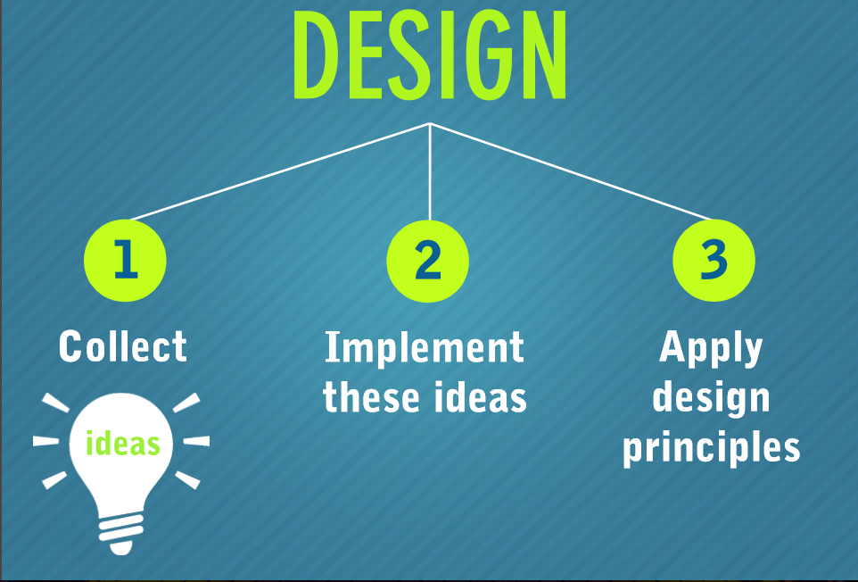

Slide 25
Create an effective web design by applying key visual elements

Slide 26
ELEMENT 1: LAYOUT
Maintain balance, consistency and the integrity of the design.

Slide 27
ELEMENT 2: COLOR
should represent your personality or the brand of an organization. COLOR

Slide 28
ELEMENT 3: graphics
Logos, images, and graphics that can help enhance your design. GRAPHICS
Make sure to place them strategically.
Use graphics wisely!

Slide 29
ELEMENT 4: fonts
Typography can enhance your design… when used wisely.

Slide 30
ELEMENT 5: Content
Should be useful and relevant.
Optimize for search engines.

Slide 31
Is your website user friendly?

Slide 32
USER-FRIENDLY DESIGN ELEMENT 1: navigation

Slide 33
USER-FRIENDLY DESIGN ELEMENT 2: compatibility

Slide 34
USER-FRIENDLY DESIGN ELEMENT 3: EASY ACCESSIBILITY

Slide 35
USER-FRIENDLY DESIGN ELEMENT 4: WELL-FORMATTED CONTENT

Slide 36
Keep yourself updated by knowing the different web design trends.

Slide 37
ASSIGNMENT

Slide 38
What software will be used for web designing?

Slide 39
What are web design latest trends?

Slide 40
What are website templates? And how can we use website templates in our website?

